Slide 1
CG2271 Real Time Operating Systems
Lab Lecture 1
Introduction to the Cortex M0+ Microcontroller

Slide 2

Overview
Cortex-M0+ Processor Core Registers
Memory System and Addressing

Slide 3
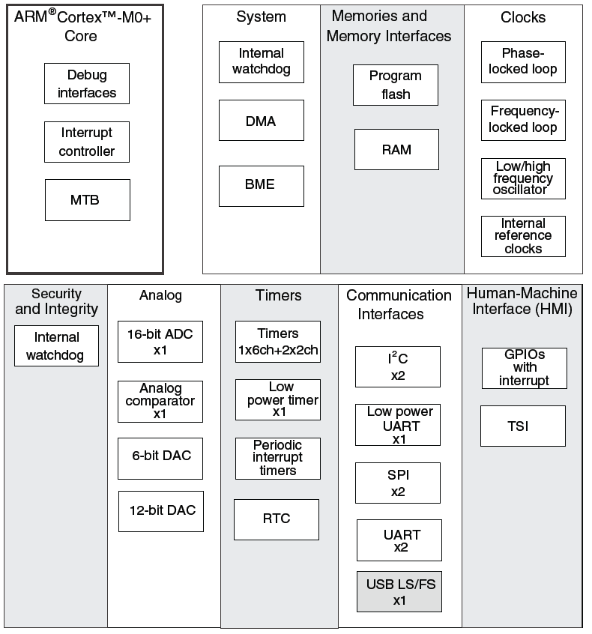
Microcontroller vs. Microprocessor
Both have a CPU core to execute instructions
Microcontroller has peripherals for embedded interfacing and control
  Analog
  Timers
  Digital I/O
  …

Slide 4
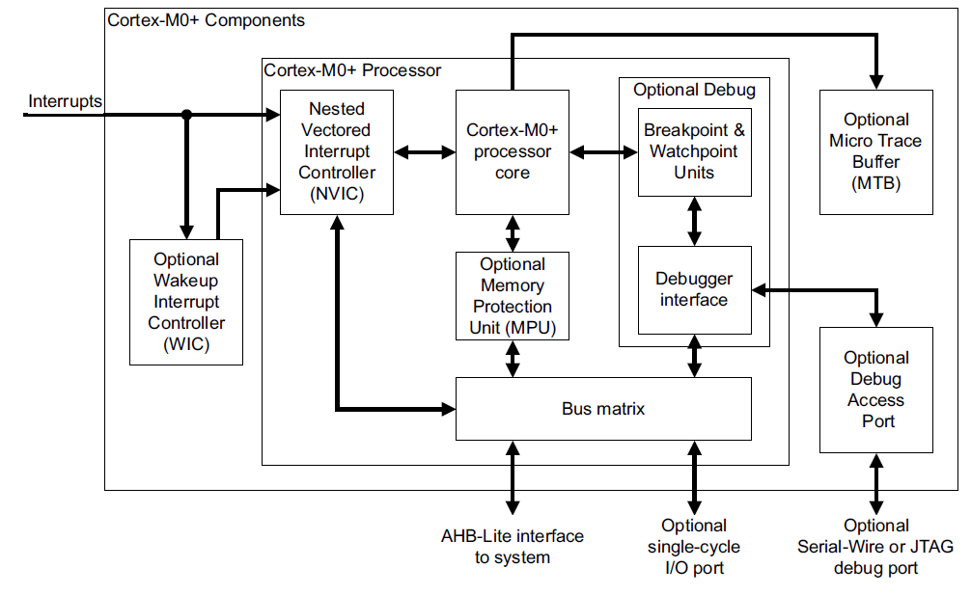
Cortex-M0+ Core
Notes:
The Cortex-M0+ core contains many components. At the center of the Cortex-M0+ Processor is the processor core, which communicates with memory to get instructions and access data. Memory is not shown on this diagram, but is connected via the AHB-Lite interface. The bus matrix shares the memory bus among multiple possible readers and writers. An optional memory protection unit enables the system to restrict a task to using only a limited region of memory, limiting the effects of bugs. Interrupts come to the processor core through the Nested Vectored Interrupt Controller (NVIC), which prioritizes and filters them as needed. The optional Wakeup Interrupt Controller cuts power consumption by letting the NVIC and the rest of the processor go to a low-power sleep mode and waking them up if an interrupt is requested. Several modules provide debug support, including downloading code to the MCU’s memory, setting breakpoints to control program execution, and tracing the sequence of instructions actually executed.

Slide 5
Architectures and Memory Speed
Load/Store Architecture
  Developed to simplify CPU design and improve performance
          Memory wall: CPUs keep getting faster than memory
          Memory accesses slow down CPU, limit compiler optimizations
          Change instruction set to make most instructions independent of memory
  Data processing instructions can access registers only
    Load data into the registers
    Process the data
    Store results back into memory
  More effective when more registers are available
Register/Memory Architecture
  Data processing instructions can access memory or registers
  Memory wall is not very high at lower CPU speeds (e.g. under 50 MHz)

Slide 6
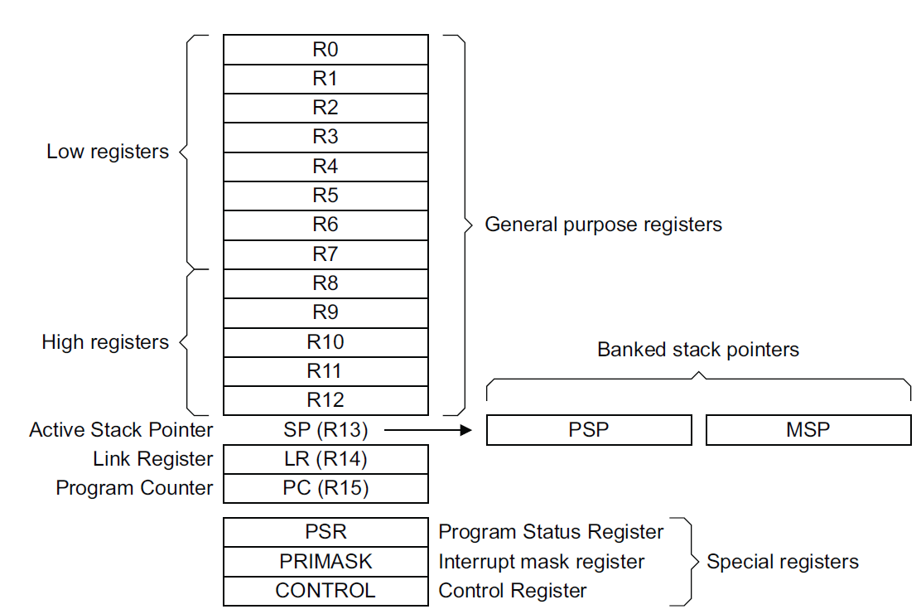
ARM Processor Core Registers
Notes:
The ARM programmer’s model (or Instruction Set Architecture) features multiple 32-bit registers. Some of them are for general use, while others are specialized.

Slide 7
ARM Processor Core Registers (32 bits each)
R0-R12 - General purpose registers for data processing
SP - Stack pointer (R13)
  Can refer to one of two SPs
          Main Stack Pointer (MSP)
          Process Stack Pointer (PSP)
  Uses MSP initially, and whenever in Handler mode
  When in Thread mode, can select either MSP or PSP using SPSEL flag in CONTROL register.
LR - Link Register (R14)
  Holds return address when called with Branch & Link instruction (B&L)
PC - program counter (R15)

Slide 8
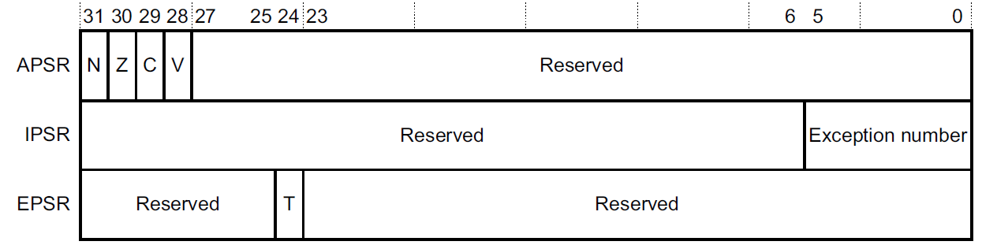
ARM Processor Core Registers
Program Status Register (PSR) is three views of same register
  Application PSR (APSR)
          Condition code flag bits Negative, Zero, oVerflow, Carry
  Interrupt PSR (IPSR)
          Holds exception number of currently executing ISR
  Execution PSR (EPSR)
          Thumb state

Slide 9
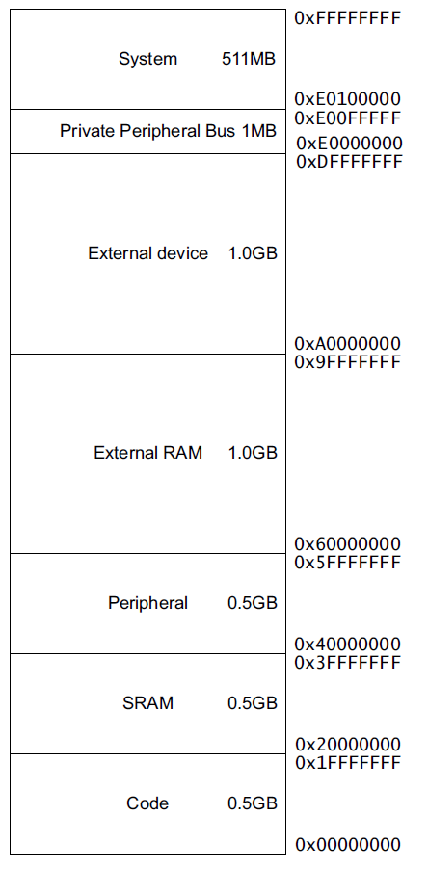
Memory Maps For Cortex M0+ and MCU
KL25Z128VLK4
0x2000_2FFF
16 KB SRAM
SRAM_U (3/4)
0x2000_0000
SRAM_L (1/4)
0x1FFF_F000
0x0001_FFFF
128KB Flash
0x0000_0000
Notes:
The ARM ISA has a 32-bit address space, allowing up to 2³² bytes of data to be addressed. This address space is divided into various regions for different uses. In the KL25Z128VLK4, 128 KB of Flash ROM is located in the bottom of the code memory at addresses 0x0000_0000 to 0x0001_FFFF. 16 KB of read/write memory (called SRAM, static RAM) is located straddling the Code and SRAM regions, from 0x1FFF_F000 to 0x1FFF_FFFF (Code region) and 0x2000_0000 to 0x2000_2FFF (SRAM region).
Additional space is reserved for other purposes, including peripherals and external RAM.

Slide 10
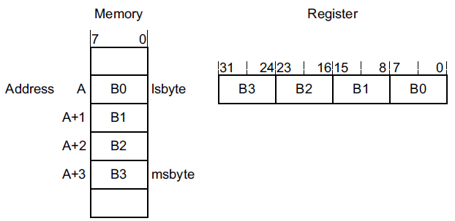
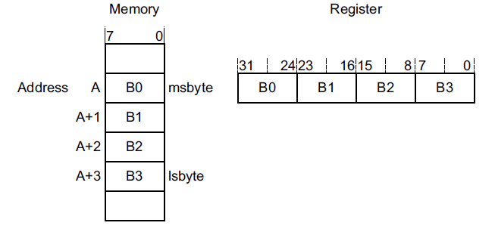
Endianness
For a multi-byte value, in what order are the bytes stored?
Little-Endian: Start with least-significant byte
Big-Endian: Start with most-significant byte
Notes:
When storing a multibyte value in memory, which end is stored first? The little end (LSB) or the big end (MSB)?

Slide 11
ARMv6-M Endianness
Instructions are always little-endian
Loads and stores to Private Peripheral Bus are always little-endian
Data: Depends on implementation, or from reset configuration
  Kinetis processors are little-endian

